Slide 1

Presentation on Healthcare in Dialysis
By,
Group 6

Slide 2
Introduction
Dialysis Healthcare analytics involves the analysis of key performance indicates to gain insights and make data-driven decision in the field of dialysis care.
It includes monitoring the number of patient across various summaries, comparing profit vs non profit stats. Chain Org based on total performance score, analysing dialysis station stats, examining category text for as expected and tracking average payment reduction rate.
By leveraging this analysis, healthcare providers can optimize care delivery. Improve Operational efficiency, enhance financial performance and ultimately improves patient’s health.

Slide 3
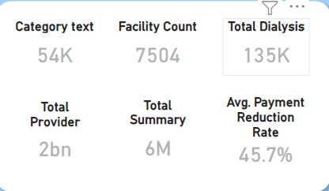
Data Measures-

Slide 4
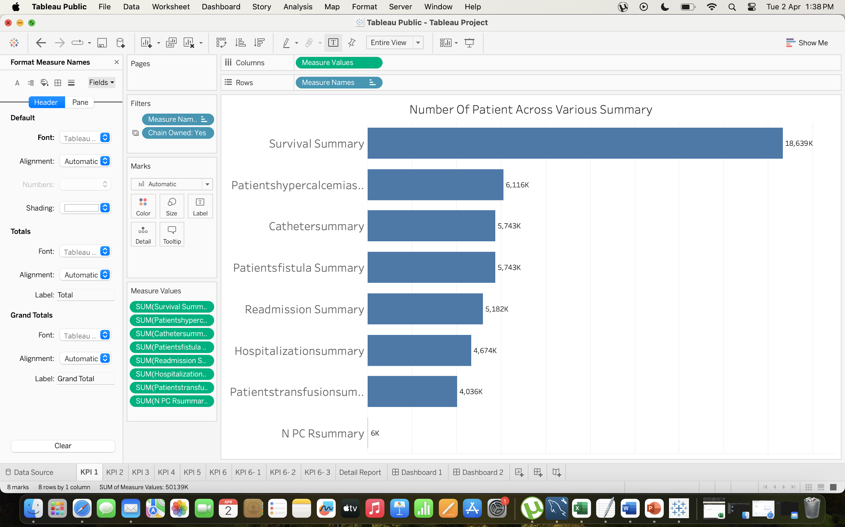
KPI 1: Number of Patients across various summaries
The Survival Summary has 18,639k patients which is the highest as compared to the other summaries. Survival Summary has 36% of total patients across all various summaries.
Followed by serum phosphorus Summary and hypercalcemia summary each has 12% of the total Patients.
Long term Catheter Summary is the 3rd Highest summary which has 11% of the total patients.
While nPCR summary is the lowest number of patients.

Slide 5
KPI 2: Profit Vs Non-Profit Stats
Total Dialysis Station which is chain owned Organization has made profit of 92 %. Also Total Dialysis Station which is not chain owned has made profit of 58 %.
Total Dialysis Station which is chain owned Organization has made non profit of 42 %. Also Total Dialysis Station which is not chain owned has made non profit of 8 %.
It concludes that dialysis station are profitable if they owned by chain organization.
Individual dialysis stations are not able to make profit.

Slide 6
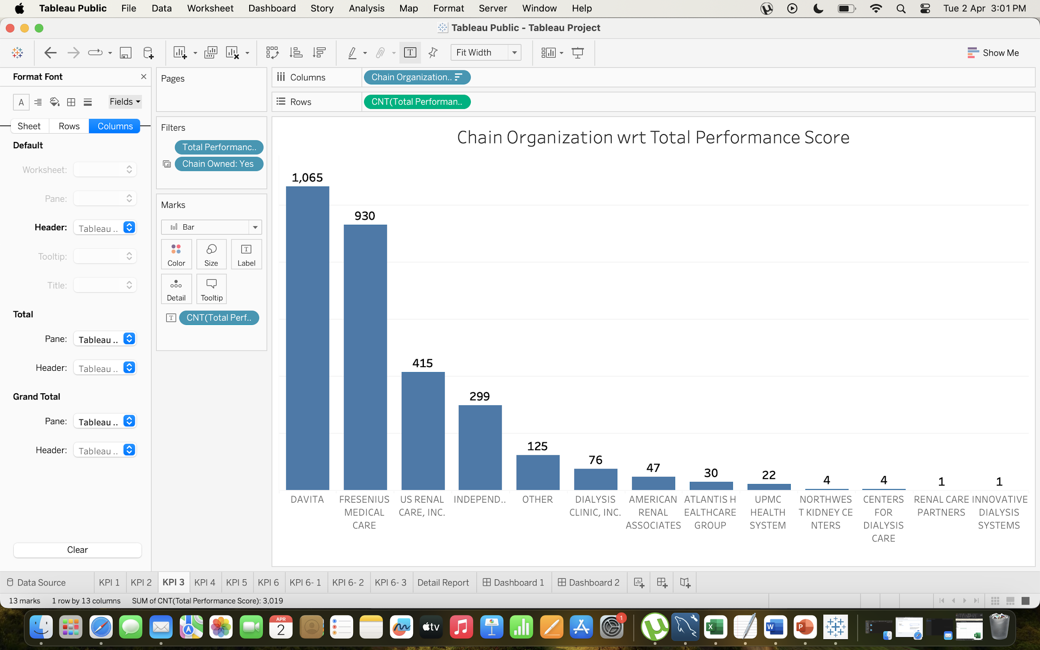
KPI 3: Chain Organizations w.r.t. Total Performance Score as “No Score”
Here are Chain Organization which has best performance score.
DAVITA organization has the performance score which is 1065, which increases the rating. DAVITA organisation has got 3.9 out 5 as average rating.
Fressenius Medical Care has got 2nd Highest performance score and has 3.8 as average rating.
There are top 7 Organization and alter this other Organization has less than 50 as total score.
High performance score signifies that chain Organization is better in terms of facilities and treatment.
As a result they are profitable and getting higher rating and preference by patients.

Slide 7
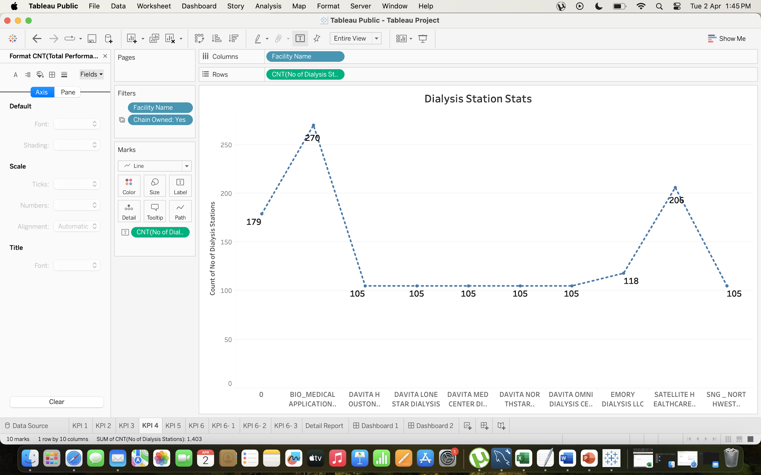
KPI 4: Dialysis Stations Stats
1) Here are Facility centre which has Top 10 highest number of Dialysis Station Stats.
2) Bio-Medical Application facility has highest number of the dialysis station which is 270, al 60% of Facility among Top 10 Facility has same number of Dialysis station which is 105.
3) Satellite healthcare has got 2nd Highest dialysis station among all.
4) High Dialysis station stats signifies that Facility centre is better in terms of facilities and treatment.
5) As a result they are profitable and getting higher rating and preference by patients.

Slide 8
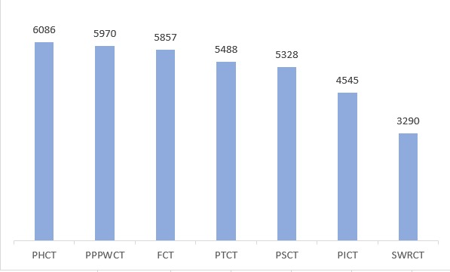
KPI 5: # of Category Text - As Expected
Here are count of all category text with “As Expected” filter.
Patient hospitalization category text has highest number of “AS EXPECTED” category text which is 6086 in number.
SWRCT i.e SWR Category text has lowest number of “AS EXPECTED” Category Text which is 3290, having just difference of 2796 which is almost below the half of highest category text.
SWRCT fall under alarming zone , which is needed to work on that more efficiently and change the strategical plans accordingly.

Slide 9
Conclusion:
The SURVIVAL SUMMARY has highest number of patient. While nPCR summary is the lowest number of patients.
Dialysis station are profitable if they are owned by chain organization while individual dialysis stations does not make profit
Among chain organization DAVITA organization has highest performance score while FRESSENIUS MEDICAL CARE has got 2nd highest performance score. High performance score signifies that chain organization is better in terms of facilities and treatment.
Among top 10 facility BIO-MEDICAL APPLICATION facility has highest number of the dialysis station
And SATELLITE HEALTHCARE has got 2nd highest dialysis station among all.
PATIENT HOSPITALIZATION CATEGORY TEXT has highest number of “as expected” category text. SWRCT i.e SWR category text has lowest number of “AS EXPECTED” category text , having difference of half of highest category text.
So, SWRCT fall under alarming zone , which is needed to work on that more efficiently and change the strategical plans accordingly.

Slide 10
Recommendation:
Dialysis station should be focused on running with any organization this will give rise to their business. Market research should be done on high performance score organization, this will give the idea of which measures are giving these organization high quality services and should apply those in low or medium score performance organization.
Swr category text fall under alarming zone , which is needed to work on that more efficiently and change the strategical plans accordingly.

Slide 11
Thankyou

